Slide 1
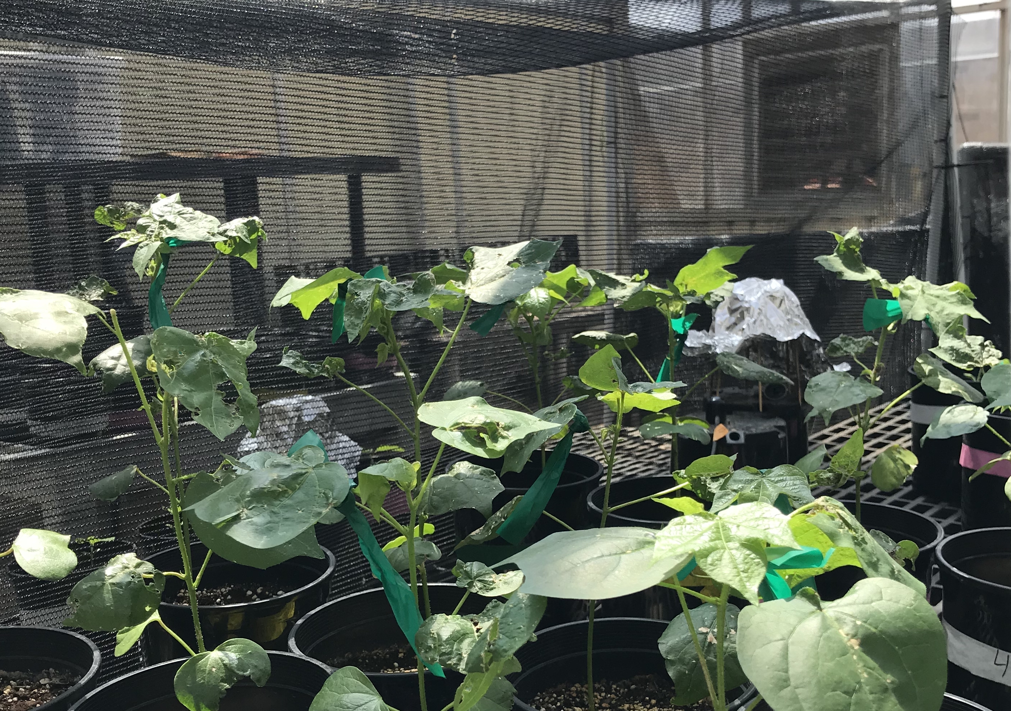
Carbon costs to acquire nitrogen are determined by interactions between nitrogen availability and light availability in two species with different acquisition strategies
Evan A. Perkowski; Elizabeth F. Waring; Nicholas G. Smith
1
Follow me on Twitter! @EvanPerkowski

Slide 2

Plant nitrogen acquisition is a process in terrestrial systems where carbon and nitrogen are tightly coupled
CO₂
2
Schematic adapted from Brzostek et al. (2014) JGR Biogeosciences
Notes:
This is an overly simplistic schematic that I hope will demonstrate this
Plants draw carbon dioxide in from the atmosphere and convert this to simple sugars

Slide 3
Plant nitrogen acquisition is a process in terrestrial systems where carbon and nitrogen are tightly coupled
CO₂
NPP
3
Schematic adapted from Brzostek et al. (2014) JGR Biogeosciences
Notes:
This supports net primary production, and allows plants to allocate carbon toward two primary pathways

Slide 4
Plant nitrogen acquisition is a process in terrestrial systems where carbon and nitrogen are tightly coupled
CO₂
NPP
C_{transfer}
C_{growth}
4
Schematic adapted from Brzostek et al. (2014) JGR Biogeosciences
Notes:
First, plants might use carbon to support whole plant growth. This may be through woody tissue production, leaf production and maintenance, or toward storage
Alternatively, plants might use carbon to support soil resource uptake. This can either be through fine root production, root exudation, or carbon exchange with microbial symbionts

Slide 5
Plant nitrogen acquisition is a process in terrestrial systems where carbon and nitrogen are tightly coupled
CO₂
NPP
C_{transfer}
C_{growth}
N_{growth}
N_{available}
5
Schematic adapted from Brzostek et al. (2014) JGR Biogeosciences
Notes:
Plants use carbon allocated belowground to acquire important resources that support photosynthetic and metabolic demand. While there are a ton of different nutrients plants acquire, plants acquire nitrogen in the largest quantity.
Once acquired, nitrogen can be used for maintenance of structural tissue, production and maintenance of photosynthetic enzymes, and many other important functions that are critical for the growth, reproduction, and survival of an individual plant.

Slide 6
Plant nitrogen acquisition is a process in terrestrial systems where carbon and nitrogen are tightly coupled
CO₂
There are inherent carbon costs associated with acquiring nitrogen
NPP
C_{transfer}
C_{growth}
N_{growth}
N_{available}
6
Schematic adapted from Brzostek et al. (2014) JGR Biogeosciences
Notes:
However, plants are not able to acquire nitrogen without first allocating carbon belowground.
Thus, there are inherent carbon costs associated with acquiring nitrogen.
These can include structural carbon costs associated with root production and maintenance, or active carbon costs associated with exchange of carbon to microbial symbionts.

Slide 7
Soil nitrogen availability may decrease carbon costs to acquire nitrogen as a function of increased per-root nitrogen uptake
CO₂
NPP
C_{transfer}
C_{growth}
N_{growth}
N_{available}
7
Schematic adapted from Brzostek et al. (2014) JGR Biogeosciences
Notes:
Importantly, carbon costs to acquire nitrogen are dynamic and therefore are likely to change with changing aboveground and belowground environmental conditions.
Belowground, soil nitrogen availability likely plays an important role in modifying these carbon costs.
This is because increases in soil nitrogen availability do not influence plant demand to acquire soil resources, and therefore likely do not have a large impact on the magnitude of belowground carbon investments.
Thus, if plants acquire additional nitrogen without a proportional change in belowground carbon, then carbon costs to acquire nitrogen would likely decrease with increasing soil nitrogen availability.
This could be indexed through increased per-root nitrogen uptake in species that acquire most of their nitrogen through direct uptake

Slide 8
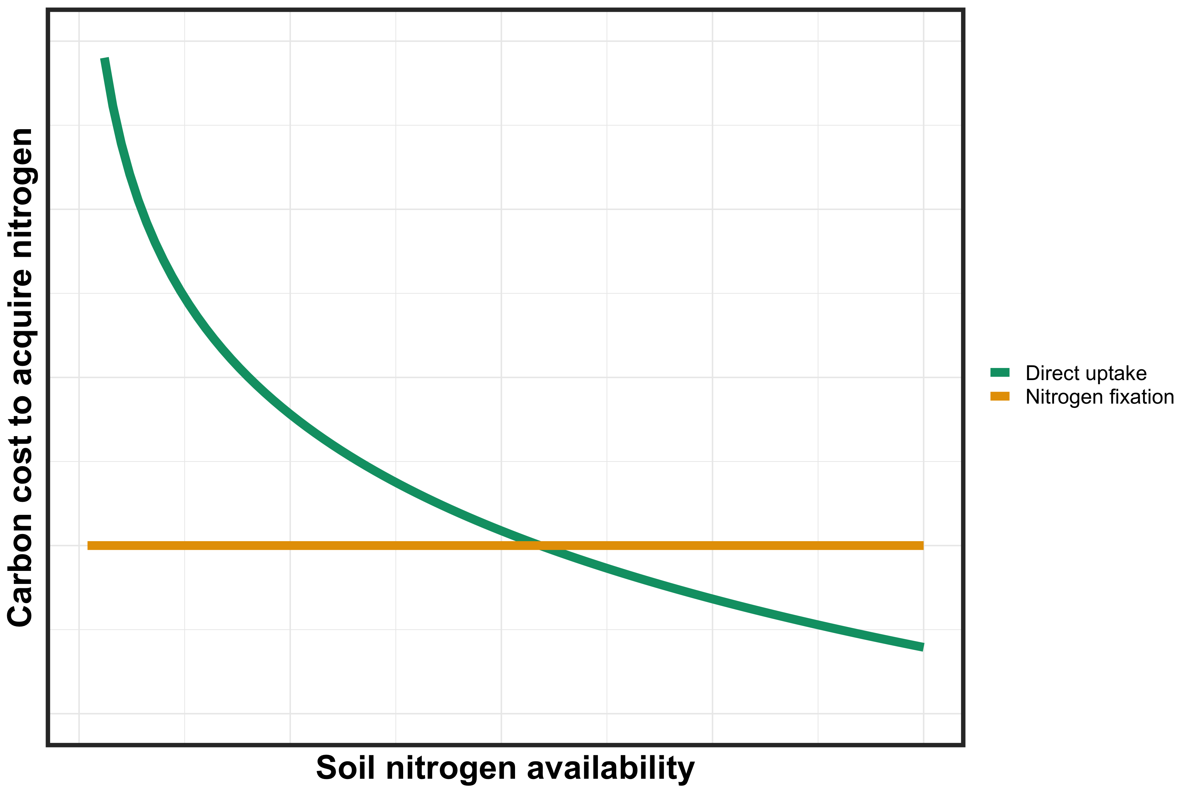
However, effects of soil nitrogen availability on carbon costs to acquire nitrogen may be context dependent on species nitrogen acquisition strategy
8
Notes:
It is important to note, however, that effects of soil nitrogen availability on carbon costs to acquire nitrogen may be context dependent on species nitrogen acquisition strategy.
This has been shown in several modeling studies and meta-analyses in species that associate with different types of mycorrhizal fungi, species that associate with nitrogen fixing bacteria, and species that acquire nitrogen mostly via direct uptake
This figure describes the hypothesized relationship between soil nitrogen availability, represented on the x-axis, and carbon costs to acquire nitrogen, represented on the y-axis between two nitrogen acquisition strategies

Slide 9
However, effects of soil nitrogen availability on carbon costs to acquire nitrogen may be context dependent on species nitrogen acquisition strategy
9
Notes:
Species that associate with nitrogen-fixing bacteria are represented by a yellow trendline and species that acquire nitrogen via direct uptake are represented by a green trendline

Slide 10
However, effects of soil nitrogen availability on carbon costs to acquire nitrogen may be context dependent on species nitrogen acquisition strategy
10
Notes:
You can see that species that associate with nitrogen-fixing bacteria have lower carbon costs to acquire nitrogen than species that acquire nitrogen via direct uptake when soil nitrogen is less available.
This may pose a competitive advantage to species that associate with nitrogen fixing bacteria, as species would be able to acquire more nitrogen from a carbon investment
However, as soil nitrogen availability increases, species that acquire nitrogen via direct uptake experience decreased carbon costs to acquire nitrogen, likely as a function of increased per-root nitrogen uptake.
Eventually, this may lead to a scenario where it is more advantageous for species to acquire nitrogen from direct uptake pathways than through nitrogen fixation, and could cause nitrogen-fixing species to switch away from nitrogen fixation to direct uptake to maximize nitrogen uptake from a belowground carbon investment

Slide 11

Light availability may increase plant carbon costs to acquire nitrogen as a function of increased plant nitrogen demand
CO₂
Increased plant nitrogen demand should increase belowground carbon investments
NPP
C_{transfer}
C_{growth}
Over short temporal scales, this may not correspond with a simultaneous increase in plant nitrogen uptake
N_{growth}
N_{available}
11
Notes:
Finally, aboveground environmental conditions may influence carbon costs to acquire nitrogen
Specifically, environmental conditions that increase NPP and increase plant demand to acquire soil resources should increase carbon costs to acquire nitrogen over short temporal scales.
These patterns would likely be indexed through larger belowground carbon investments relative to nitrogen uptake
For example, increased light availability should increase net primary productivity, which should increase belowground carbon investments in order to acquire additional nitrogen to support higher NPP.
However, over short temporal scales, this may not correspond with an increase in plant nitrogen uptake.
This is because it takes time to build structures and exchange carbon with microbial symbionts, so there is likely a temporal lag between the time it takes to allocate carbon belowground and acquire additional nitrogen

Slide 12
Primary Research Question
How does soil nitrogen availability and light availability influence plant carbon costs to acquire nitrogen?
12
Notes:
In the context of potential sources of variation in carbon costs to acquire nitrogen, we were interested in understanding how soil nitrogen availability and light availability influenced plant carbon costs to acquire nitrogen

Slide 13
Experimental setup
Light availability treatments
Soil fertilization treatments
Species
0% shade cover
0 ppm N
30% shade cover
70 ppm N
Gossypium hirsutum
50% shade cover
210 ppm N
Glycine max
80% shade cover
630 ppm N
13
Notes:
To do this, we set up a greenhouse experiment where we grew G. hirsutum and G. max under four light levels and four soil nitrogen levels in a full factorial, random block design.
Light treatments were created using shade cloth and nitrogen fertilization treatments were created using a modified Hoagland’s solution
G. hirsutum is a woody perennial species capable of acquiring nitrogen via direct uptake or via associations with arbuscular mycorrhizal fungi
G. max is a herbaceous annual species capable of acquiring nitrogen via direct uptake or through associations with nitrogen-fixing bacteria

Slide 14
Root carbon biomass
Carbon cost to acquire nitrogen
=
Whole-plant nitrogen biomass
14
Notes:
We quantified carbon costs to acquire nitrogen as a function of root carbon biomass and whole-plant nitrogen biomass.
There are several limitations associated with this metric that I unfortunately do not have time to get into here. If you want more information about this metric, I’ve linked a QR code at the end of this talk to our recently accepted manuscript on this work.

Slide 15
Hypotheses
Positive effect
Neutral effect
Negative effect
G. max carbon costs to acquire nitrogen
Light availability
G. hirsutum carbon costs to acquire nitrogen
Nitrogen fertilization
15
Notes:
We used this experiment to test the following hypotheses
Light availability would impact carbon costs to acquire nitrogen similarly in both species.
This would likely be indexed by a larger increase in root carbon biomass than whole plant nitrogen biomass due to the short temporal scale of this study
However, we expected that nitrogen availability would impact carbon costs to acquire nitrogen differently between species
We expected that carbon costs to acquire nitrogen would decrease with increasing soil nitrogen fertilization in G. hirsutum due to an increase in per-root nitrogen uptake
However, we expected that these carbon costs would not change with soil nitrogen fertilization in G. max. This is because G. max would acquire most of its nitrogen from nitrogen fixation and independent of soil nitrogen fertilization

Slide 16
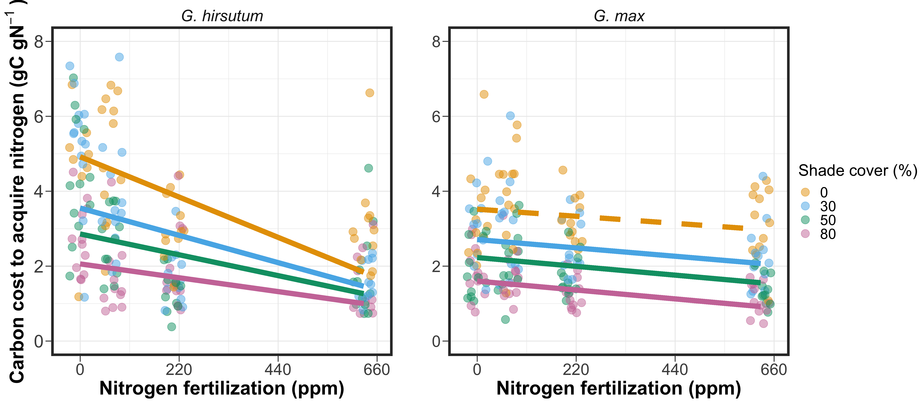
Carbon costs to acquire nitrogen decreased with increasing nitrogen fertilization, but increased with increasing light availability
16
Perkowski et al. (in press) JXB
Notes:
All figure axes have soil nitrogen fertilization on the x-axis and the response variable (carbon costs to acquire nitrogen in this case) on the y-axis.
On the left panel is cotton and on the right panel is soybean
Colored points and trendlines represent light treatments, and dashed lines indicate trendlines that are not different from zero
Arrows about intercept/slope

Slide 17
Carbon costs to acquire nitrogen decreased with increasing nitrogen fertilization, but increased with increasing light availability
17
Perkowski et al. (in press) JXB
Notes:
We found that nitrogen fertilization generally decreased cotton carbon costs to acquire nitrogen regardless of light level.
In all cases, this was the result of a larger increase in whole plant nitrogen biomass than root carbon biomass.

Slide 18
Carbon costs to acquire nitrogen decreased with increasing nitrogen fertilization, but increased with increasing light availability
18
Perkowski et al. (in press) JXB
Notes:
Additionally, we found that light availability increased cotton carbon costs to acquire nitrogen
In all cases, this was indexed by a larger increase in root carbon biomass than whole plant nitrogen biomass

Slide 19
Carbon costs to acquire nitrogen decreased with increasing nitrogen fertilization, but increased with increasing light availability
19
Perkowski et al. (in press) JXB
Notes:
Interestingly, we found the same patterns to be true in soybean.

Slide 20
Carbon costs to acquire nitrogen decreased with increasing nitrogen fertilization, but increased with increasing light availability
20
Perkowski et al. (in press) JXB
Notes:
Where nitrogen availability generally decreased carbon costs to acquire nitrogen…

Slide 21
Carbon costs to acquire nitrogen decreased with increasing nitrogen fertilization, but increased with increasing light availability
21
Perkowski et al. (in press) JXB
Notes:
… and light availability generally increased carbon costs to acquire nitrogen

Slide 22
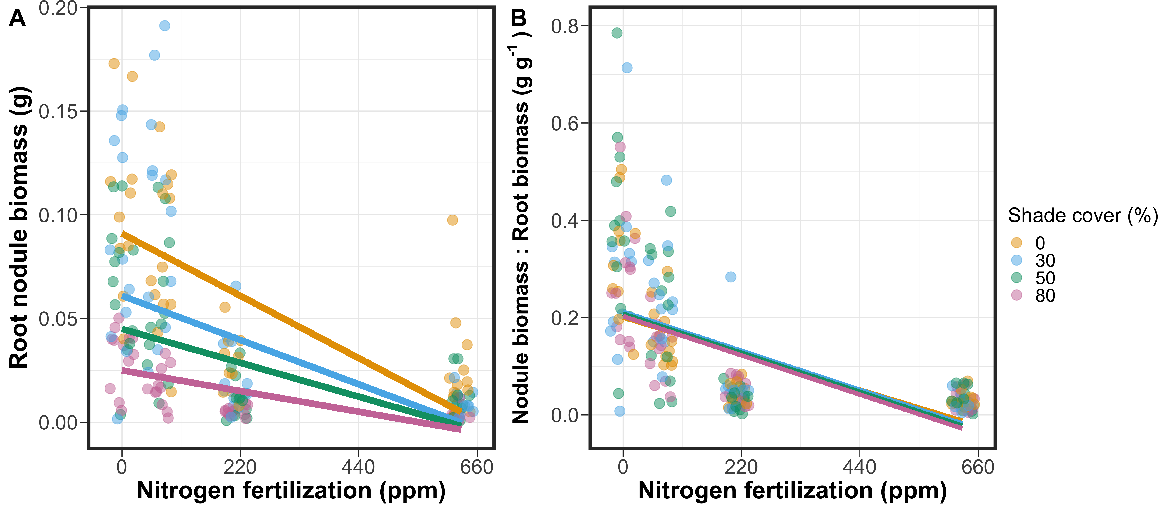
G. max decreased investment in root nodules with increasing nitrogen fertilization
22
Perkowski et al. (in press) JXB
Notes:
These patterns for soybean did not necessarily follow from our original hypotheses
However, these patterns make a bit more sense when we look at root nodulation data

Slide 23
G. max decreased investment in root nodules with increasing nitrogen fertilization
23
Perkowski et al. (in press) JXB
Notes:
We found that increasing soil nitrogen fertilization decreased root nodule biomass regardless of light level.
This likely decreased the nitrogen fixation capacity of soybean individuals; however, occurred alongside an increase in whole plant nitrogen biomass with increasing nitrogen fertilization
This suggests that soybean individuals growing under high levels of soil nitrogen may have been accessing nitrogen from an alternative source aside from nitrogen fixation

Slide 24
G. max decreased investment in root nodules with increasing nitrogen fertilization
24
Perkowski et al. (in press) JXB
Notes:
Indeed, when we look at the ratio of root nodule biomass to root biomass, we see that root nodule biomass is decreasing relative to root biomass regardless of light level.
This suggests that individuals may have switched their dominant mode of nitrogen acquisition from nitrogen fixation to direct uptake

Slide 25


Summary of Findings
Positive effect
Neutral effect
Negative effect
G. max carbon costs to acquire nitrogen
Light availability
G. hirsutum carbon costs to acquire nitrogen
Nitrogen fertilization
25
Notes:
To put our findings together:
We found that light availability increased carbon costs to acquire nitrogen in both species, which supported our hypothesis.
We also found that, in support of our hypothesis, nitrogen fertilization decreased carbon costs to acquire nitrogen in cotton.
This was presumably due to an increase in per-root nitrogen uptake
However, we observed similar patterns in soybean, which did not support our hypothesis.
Root nodulation data suggests that these patterns were due to a shift in the dominant mode of nitrogen acquisition from nitrogen fixation to direct nitrogen uptake

Slide 26
Future Work
Larger range of taxonomically related species across multiple spatiotemporal scales to better understand generality of these patterns
At what point do nitrogen-fixing species shift from nitrogen fixation to direct uptake? Is this in agreement with Earth system models?
26
Notes:
We did not compare carbon costs to acquire nitrogen between species.
This is because cotton and soybean are not phylogenetically related and we are extremely limited in our ability to extrapolate these patterns to all nitrogen-fixing or non nitrogen-fixing species.
Therefore, future work will entail using a larger range of taxonomically related species to determine how generalizable these patterns are.
Additionally, this study was conducted over a short 5-week temporal scale, so there is also a need to evaluate these patterns across multiple spatiotemporal scales to determine the spatiotemporal range for which these patterns hold
Finally, we would love to evaluate the soil nitrogen threshold whereby nitrogen-fixing species shift from nitrogen fixation to direct uptake and to compare these results to patterns simulated by Earth system models.

Slide 27
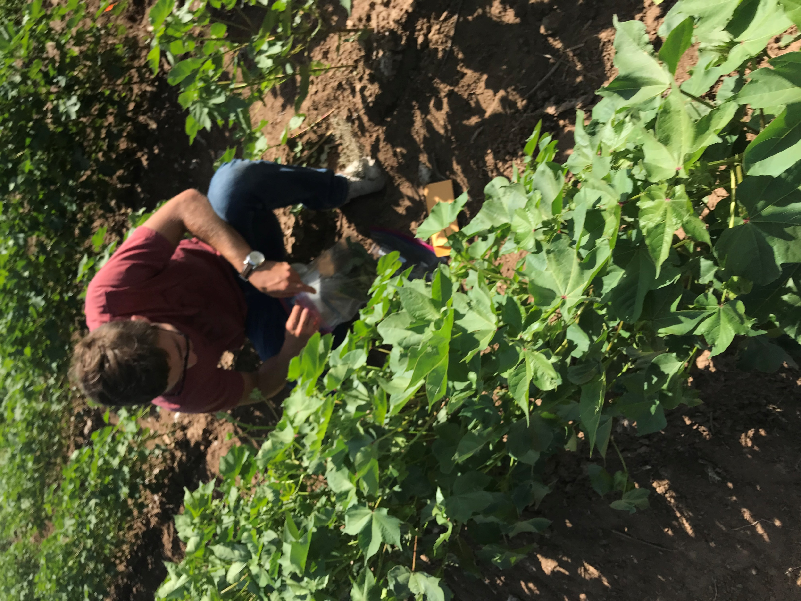
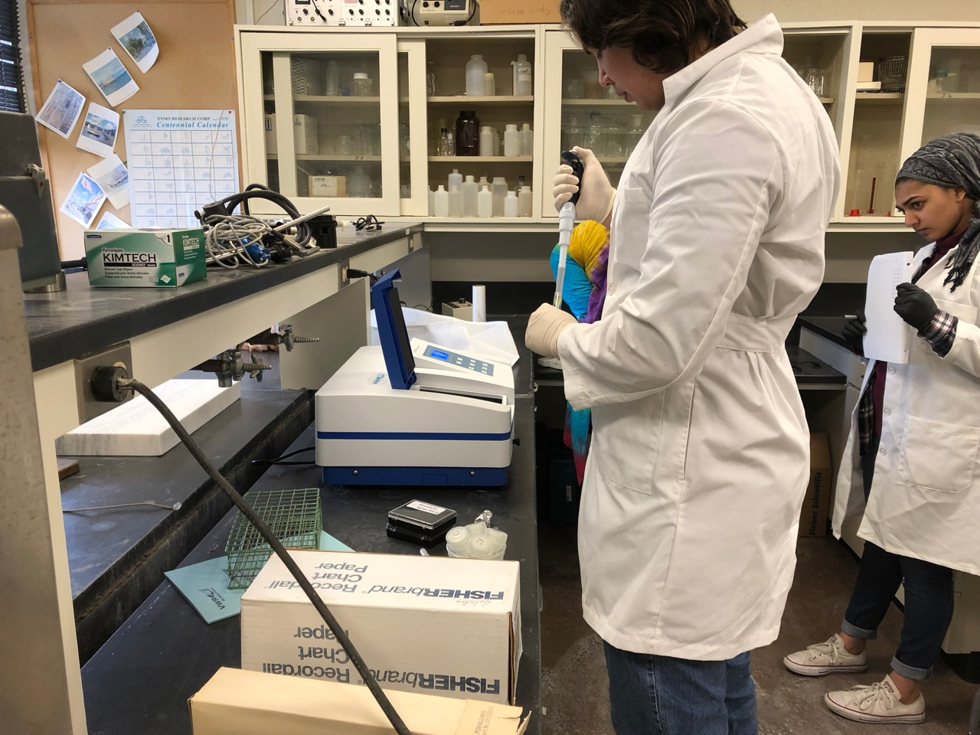
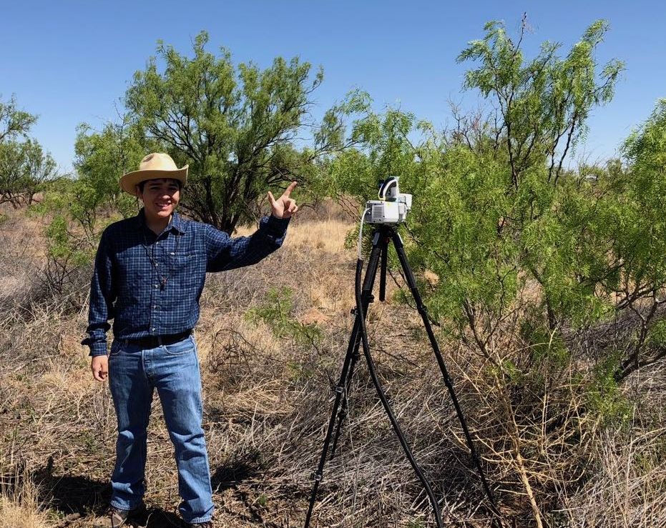
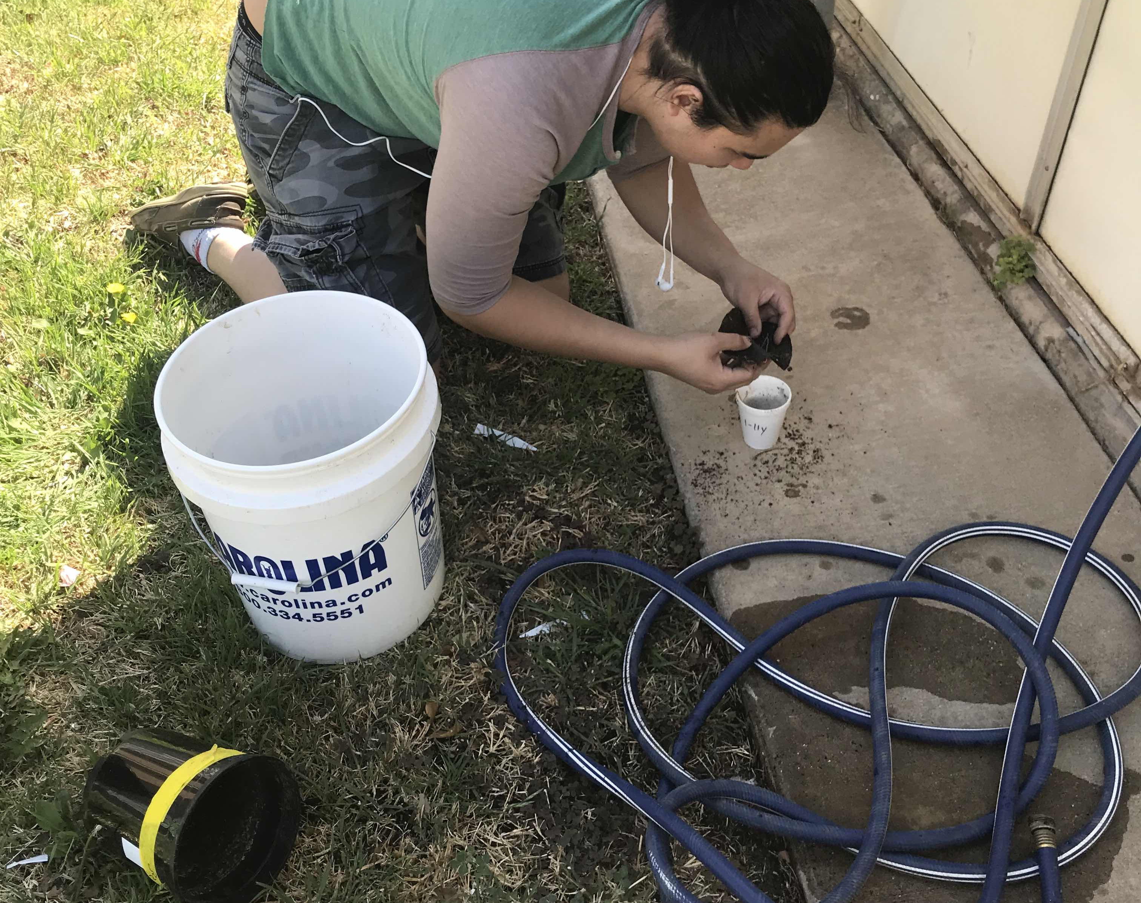
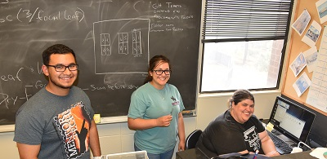
Acknowledgements
Undergraduate Researchers:
Josh Gutierrez
Jorge Ochoa
Austin Cooper
Mahum Haque
Angel Barron
Leah Ortiz
Kobe Young
Dave Baychoo
Zachary Bailey
Members of the Schwilk and van Gestel Lab
Dr. Paxton Payton (USDA)
Notes:
Finally, this work could not have been done without the help of several undergraduate students and feedback from members of the Schwilk and van Gestel Lab. We would also like to thank Dr. Paxton Payton at the USDA station in Lubbock for providing us with cotton and soybean seeds

Slide 28

For more information about this work, scan the QR code with your phone camera to navigate to our recently accepted manuscript:
Notes:
For those interested, this work is part of a recently accepted manuscript at the Journal of Experimental Botany. If you scan the QR code below with your phone, you will be able to access the manuscript landing page.

Slide 29
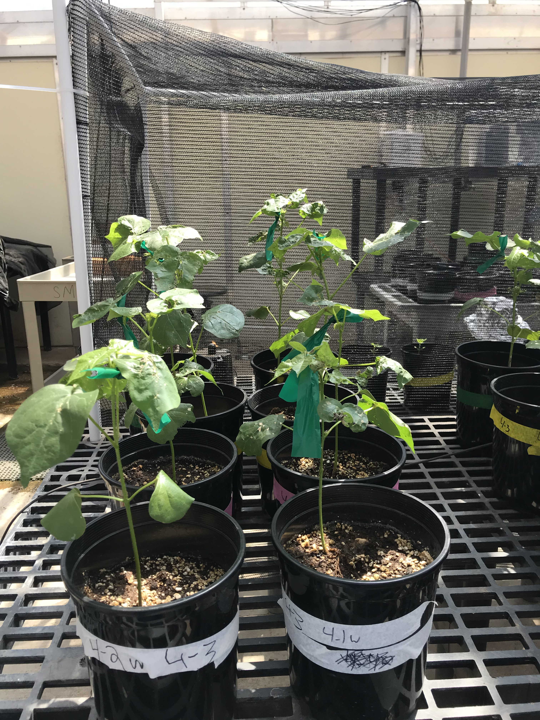
Thank you!

